Slide 1
Introduction to XML
Notes:
-some of you taking this course have already worked with HTML.
-HTML is helpful, it’s not essential.
-while HTML was great a displaying information, it was poor at organizing.
-XML was created to help store and manage information and data.
-over the past 15 years or so, XML has become a powerful tool organize, manipulate, and display data
-together with its related technologies, XML is essential for anyone working with almost any kind of data
-in a nutshell: XML was designed to describe data, whereas HTML was designed to display data.

Slide 2
What is XML
It’s an acronym for eXtensible Markup Language
Tag based syntax, very much like HTML
<title> </title>
Allows us to make our own tags, hence extensible
Extensibility is its major benefit
Foundation for Web 2.0 applications such as RSS, AJAX, XHTML, and many others

Slide 3
What is XML
Designed to describe data, not display it
Tags are not predefined like HTML
W3C Standard
XML doesn’t do anything, not “programming” per se
HTML is all about “looks” where as XML is all about “brains”

Slide 4
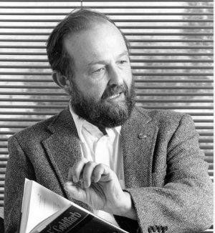
History of XML
XML developed in 1998
Evolved out of SGML, or Standard
Generalized Markup Language
SGML is a language that dates back to 1960s
SGML developed by the work of 3 people, most notably Charles Goldfarb
Harvard Law Grad that wanted a way to share docs and coined term “markup language”

Slide 5
XML History cont.
XML developed by 11 members, +150 more consultants, and 3 years to develop
1998, the W3C released XML 1.0
Last release was 1.1 in 2006
There’s talk of XML 2.0, no serious plans yet

Slide 6


Before XML there was HTML
“Gore Bill” or High Performance Computing & Communication Act of 1991
HTML or HyperTextMarkupLanguage developed 1991 by Tim Berners-Lee, inventor of the WWW
Not widely used until HTML 2.0 was released, 1995. HTML 4.0 1998, and HTML 5.0 in 2011
HTML simplified SGML so that non-experts could markup documents
HTML made the Internet revolution possible
HTML too successful!

Slide 7
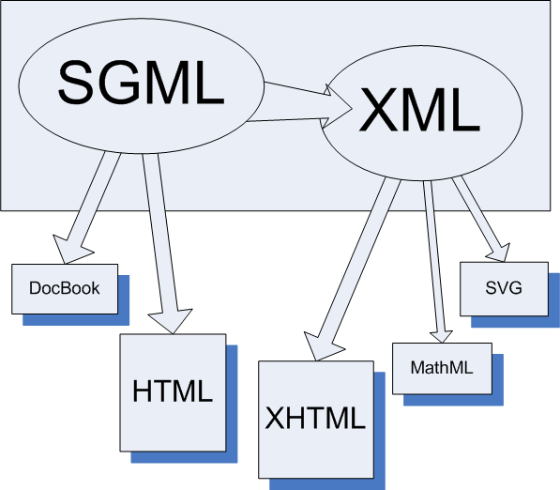
Landscape of Markup Languages

Slide 8
DocBook
A schema developed in 1991
Used to write books, especially technical information
Created and used before the advent of XML
Created and maintained in part by O’Reilly
Uses SGML and XML
Has some compatibility issues with XML tools
DocBook is on the decline

Slide 9
HTML vs. XML
Optimized for WWW
Allows non-standard markup (i.e. sloppy syntax)
Content & format not separated
Fixed set of tags, not extensible
Separates content from format
Enforces clean markup
Meaningful, self describing syntax
Tags can be user created since XML is extensible

Slide 10
HTML Lacks Meaning
What does this HTML tag mean?
<td>12208</td>
Weight of an automobile?
Number of students enrolled at UAlbany?
A zip code for an Albany address?
Appearance is the primary goal of HTML
It cannot separate content from presentation!

Slide 11
XHTML
Helped fix some of the problems found with HTML
More restrictive
Documents must be well formed ie, XHTML elements must be properly nested
No open elements i.e., <p> with no closing tag
Uses standard XML parser, not as flexible as an HTML parser
elements must be in lowercase

Slide 12
XHTML cont.
XHTML is still merely for presentation, not data
XHTML is not a replacement for XML

Slide 13
So Why Don’t We Use SGML?
Lack of web browser support because all of its development occurred before WWW
Too complicated to implement because there are too many options
Little support for style sheets, and no agreed upon standard exists for presenting SGML data

Slide 14
XML Advantages over SGML
A simplified subset of SGML (ISO 8879)
Very powerful and easy to implement
Small enough for Web browsers
Internationalized from the beginning
Unicode for both content and markup
Not a language but a meta-language
Designed to support the definition of an unlimited number languages for specific industries: "Write once, parse anywhere"

Slide 15
Unicode
an international encoding standard for use with different languages and scripts, by which nearly every possible international character (letter, digit, or symbol) is assigned a unique numeric value that applies across different platforms and programs.
XML is written in Unicode

Slide 16
XML is Self Describing
Using XML tags we can:
make relationships between data explicit
Prevent data loss due to the inability to know what the data means
enable domain specific professions a way to mark up their information how they want it.

Slide 17
Interoperability
XML can be used by a wide variety of platforms
Most major programming languages provide support
XML is a reliable, well-documented, and open standard

Slide 18
Markup Languages (MLs)
“A markup language is a modern system for annotating a document in a way that is syntactically distinguishable from the text.”*
Hundreds of MLs
Most developed in the past 20 years use XML
XML is a general purpose mark up language used to create domain-based MLs.
W3C writes standards for XML and leaves ML development to individuals and authorities within domains.
Can you think of a mark up language?
*http://en.wikipedia.org/wiki/Markup_language (accessed 6/26/2012)

Slide 19
Markup Languages
MAchine Readable Cataloging(MARC) not XML but MARC XML is!
Sports Markup Language (SportsML).
Mathematical Markup Language (MathML)
Green Building XML (gbXML)
Text Encoding Initiative (TEI)
Encoded Archival Description (EAD)

Slide 20
XML powers Web 2.0+
It’s the backbone of the Semantic Web
Integral to Linked Data
Integral to Web 2.0 and 3.0
RSS feeds
AJAX functionality like “auto suggest”

Slide 21



How might we think of XML?
XML is like a mixture of
MS Word, DB, and HTML
Notes:
-XML allows us to type into it in the same manner we would when we create a Word document
-You can deal with it like an HTML document when it some day becomes a web page
-You can treat it like a database too, which is the most important.
-You can’t treat a word or HTML file as a database.

Slide 22
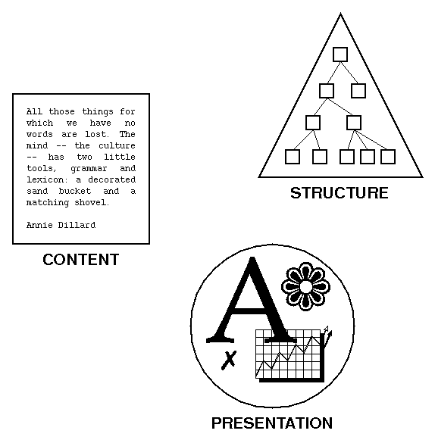
XML Separates Content, Structure & Presentation
Notes:
-Here’s another diagram that better shows what XML does: it XML Separates Content, Structure & Presentation

Slide 23
XML is like a Database
It also allows us to do things:
We can query it (SQL)
Sort it
Update, add, & delete data
Notes:
-XML also allows us to do really import functions that we can do with a database. It allows us to SORT, QUERY, and UPDATE and DELETE data

Slide 24
XML structures information
Like a database functionality, XML structures our information
Because it structures data, it can be treated like a database, but it’s more than that
XML also allows us to create narrative information in a similar way that we do in Word processor
It’s a hybrid of being data and document centric

Slide 25
XML is data & document centric
XML can represent small pieces of information or data in highly structural manner
Provides ways to reuse content
It also can represent documents in a highly structured manner too.

Slide 26
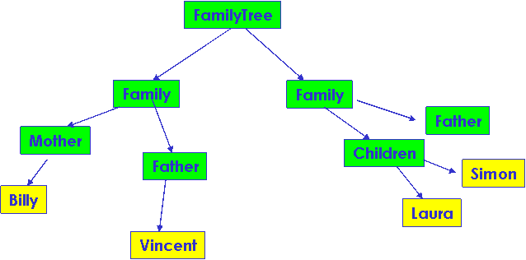
Hierarchical Data Representation

Slide 27
Root, Parents, Children, and Siblings too!
Library is the Root node
Books node is child of Library node
Library
Relationship & Node
Books is a sibling of Books
Books
Books
Books node is parent of Title node
Title
Title
Author
Author

Slide 28
XML is Human Readable
XML files can be read and inspected by a human and computer!
Database, Word processor, or Spreadsheet files (pretty much most applications) are binary files.
Binary files are only meaningful to computers

Slide 29
“XML documents should be human legible and reasonably clear.”
The meaning of an XML document should be more or less apparent from the tags.
<dog_breed>Terrier</dog_breed> GOOD
<db>Terrier</db> POOR

Slide 30
XML is not Written concisely
Since XML documents are plain text, they don’t take much memory. So there’s no point using cryptic abbreviations.
Use <first_name>Mark </first_name>,
instead of <fn>Mark</fn>.
XML is supposed to be Verbose
Notes:
-verbose versus terse

Slide 31
“XML Documents shall be easy to create.”
Many specialized editors available, but you can write perfectly good XML with just a text editor.

Slide 32
A Typical XML Architecture
Content (the XML document)
Format (the stylesheet)
Definition (the DTD)

Slide 33
How Data is Served to Web
XSL stylesheet
HTML Document
XSL stylesheet
HTML Document
XML Document
XSL stylesheet
HTML Document
XSL stylesheet
HTML Document

Slide 34
Sustainable Standard
Libraries, Archives, Banks, etc. rely on XML as a long-term standard to store their data
Human readable
Standards driven
Lightweight
Well supported
Open

